Slide 1
A visual guide to information theory-based coupling measures

Slide 3
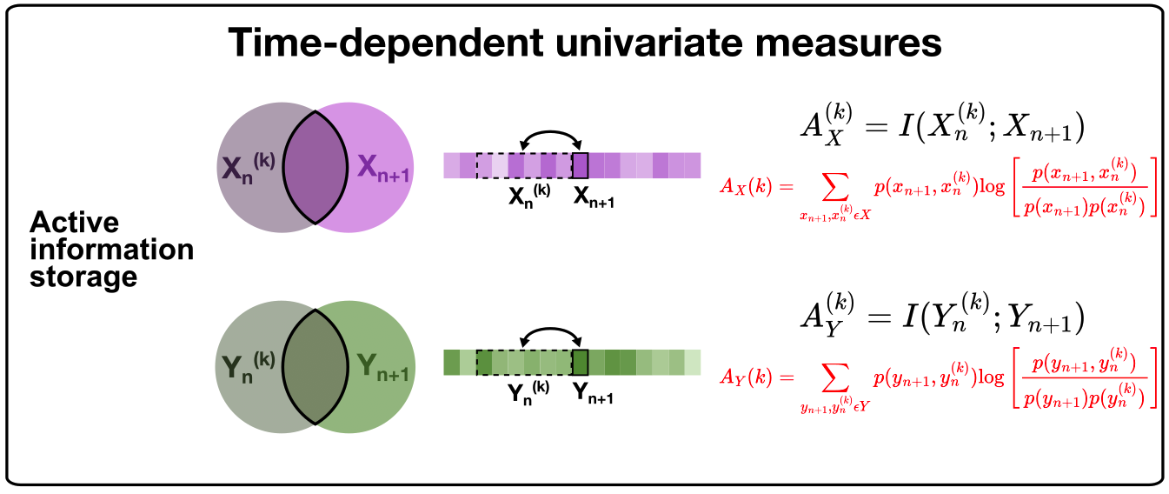
Added: Active information storage as a time-dependent univariate measure

Slide 4
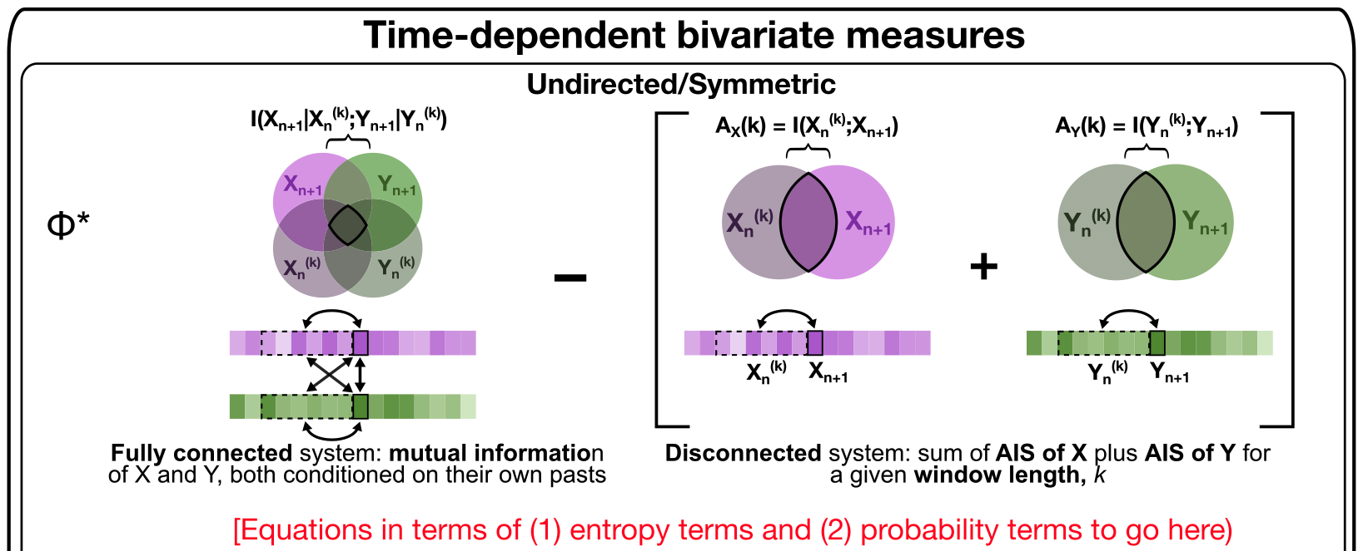
Updated: phi-star schematic
1. It seems like phi star is essentially the difference between the mutual information of the fully-connected system and the sum of the active information storage for X and Y separately, have I got that right?
2. On that, I believe you (Joe) had asked about the original publication for phi-star in order for us to properly define its form based on (1) entropy terms and (2) probability terms here. Oliver implemented phi-star directly from the PhiToolbox developed by Oizumi et al. alongside their 2016 paper: https://doi.org/10.1371/journal.pcbi.1004654

Slide 5
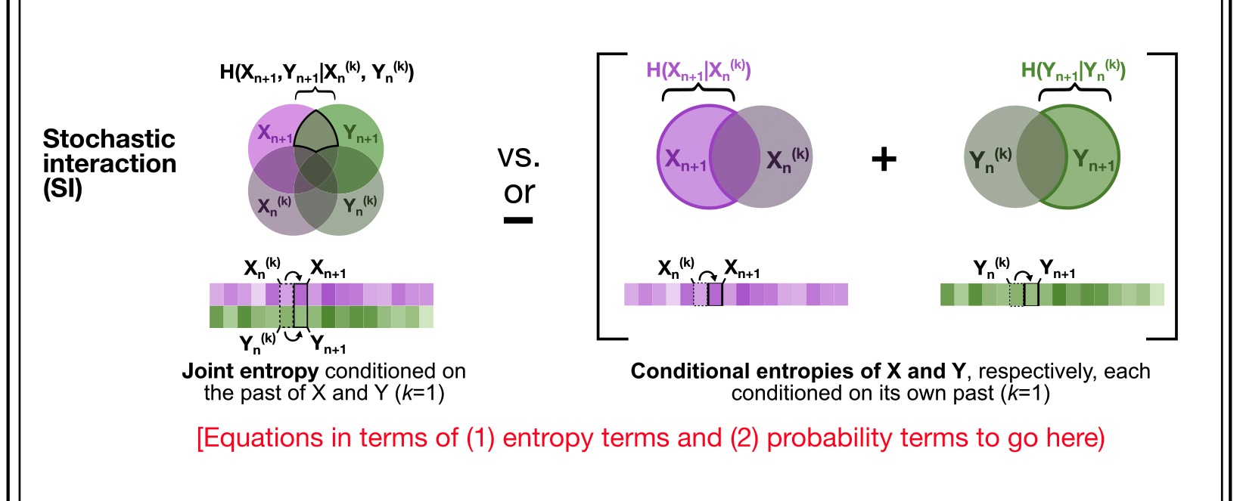
Updated: stochastic interaction
The stochastic interaction statistic does seem similar to phi-star, though as far as I can tell, the comparison is actually between different entropy terms rather than between different mutual information formulations (as in phi-star). I believe that stochastic interaction measures the difference between the joint entropy of X and Y conditioned on the past of both X and Y versus the conditional entropy of X conditioned on its own past and of Y conditioned on its own past. Does that check out?
Joe, you mentioned that the comparison might be more of a ‘versus’ than a ‘subtraction’, so I made a note of this in the schematic
We will need to add in the appropriate equations for SI here as well. Oliver cited Ay and Thomas 2003 and Ay 2015 for this metric, for reference.

Slide 6
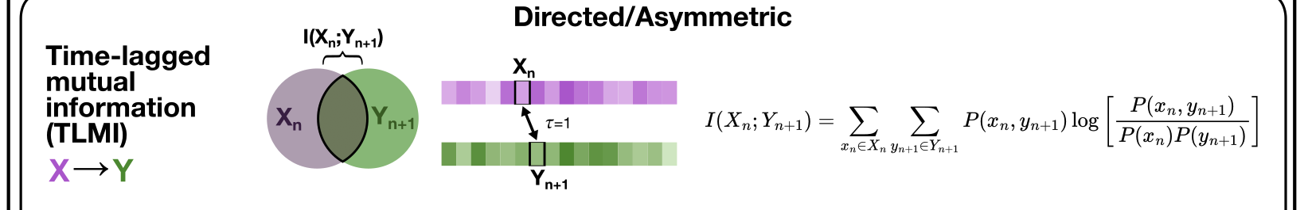
Updated: time-lagged mutual information
For time-lagged mutual information, fortunately both of your intuition was correct, that pyspi was computing the lower half of the SPI matrix and filling in the upper half automatically since TLMI was labelled as ‘undirected’. I manually checked that creating an instance of the TimeLaggedMutualInfo() object returned different values from X --> Y versus Y --> X, and I modified the infotheory.py file to indicate that this is a directed rather than undirected statistic. The calculator object now returns different values in the upper and lower half of the matrix for this SPI – will follow up with a PR to correct this.

Slide 7
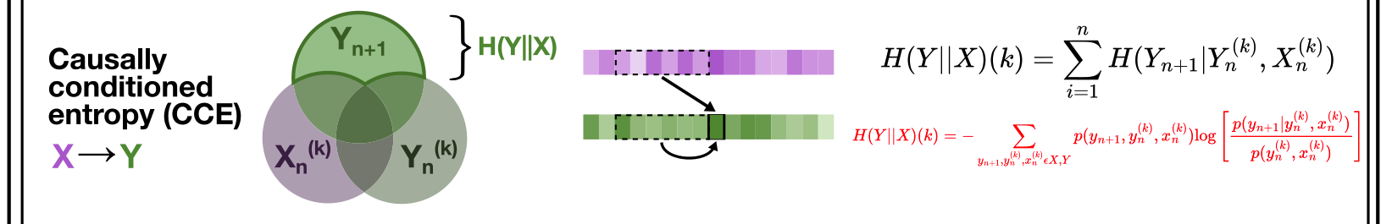
Updated: causally-conditioned entropy
For causally conditioned entropy, I filled in the equation in terms of the log probabilities for X and Y in red. Could you please check that these are right, Joe?

Slide 8
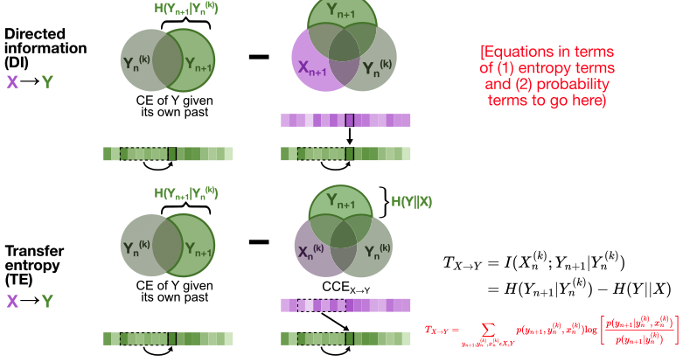
Updated: DI/TE

Slide 9
Updated: DI/TE
I split up directed information and transfer entropy, to reflect that the second term in the difference equation includes a contemporaneous measure of X for direction information (X-->Y) versus a lagged measure of X for transfer entropy (X-->Y). Based on our discussion yesterday, it seems like transfer entropy is equivalent to the conditional entropy of Y given its own past minus the causally conditioned entropy from X-->Y. However, the pyspi text + documentation states “The directed information can be computed as a difference between the conditional entropy of y given its own past, and causally conditioned entropy”, which seems to match the definition of transfer entropy rather than directed information. The three-circle Venn Diagram for directed information seems to capture a variation on CCE that includes contemporaneous signal for both source (X) and target (Y) as well as the past of the target (Y); does this map to any defined type of entropy that you know of, Joe?

